Slide 1

The University of Burdwan
Three/Four year UG course under NEP
Paper ZOOL2011
MODIFICATION OF FEET IN BIRDS
DR. SAGAR ADHURYA
Assistant Professor in Zoology
West Bengal Education Service

Slide 2
Introduction
The bird’s hindlimbs are modified according to their mode of action:
Locomotion
Adaptation to the environment
Offence and defence
Perching

Slide 3
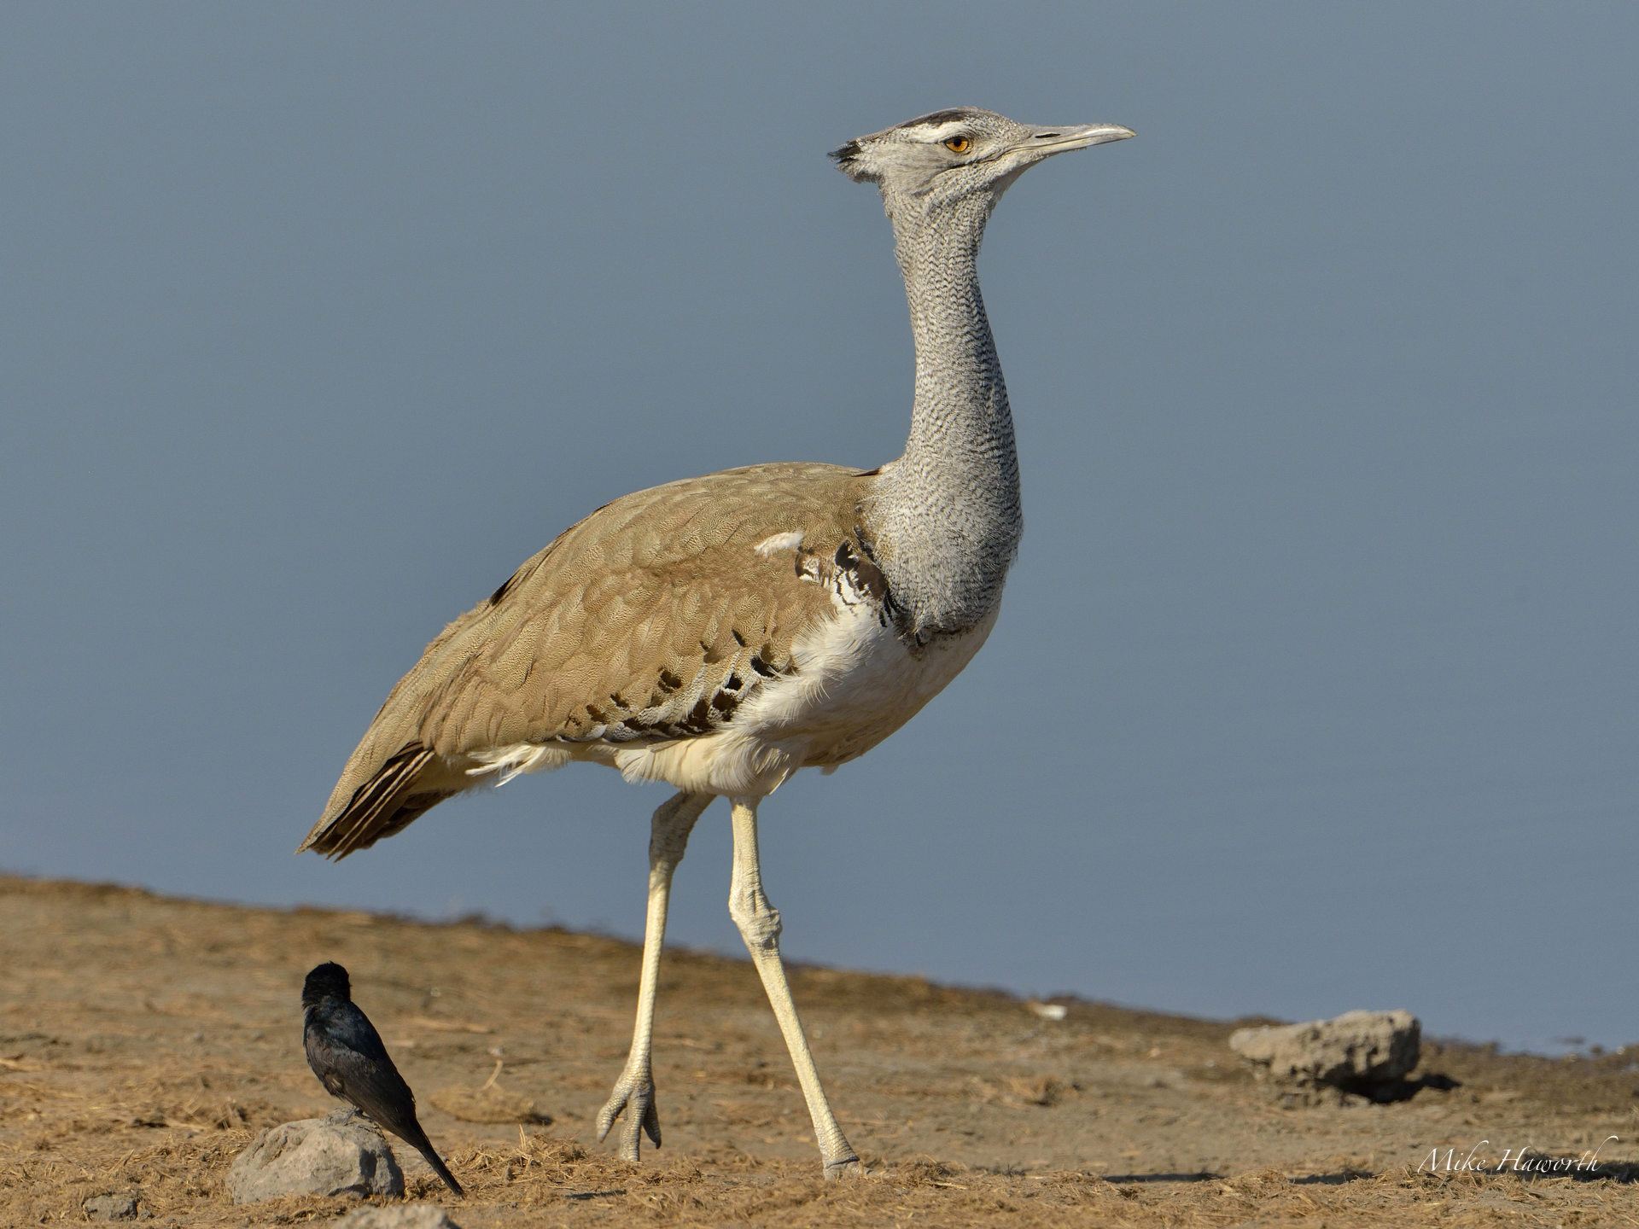
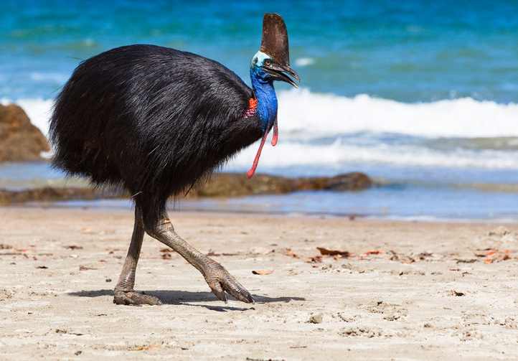
Cursorial or running feet
Strong, powerful, number of toes reduced.
Hind toes may be elevated, reduced or absent.
In bustards, coursers and ratites such as emu, rhea and cassowary, only 3 toes, directed forward, are present.
Ostrich has only 2 toes, of which the outer one is smaller and without a nail.
Great Indian Bustard
Cassowary

Slide 4
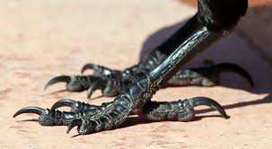
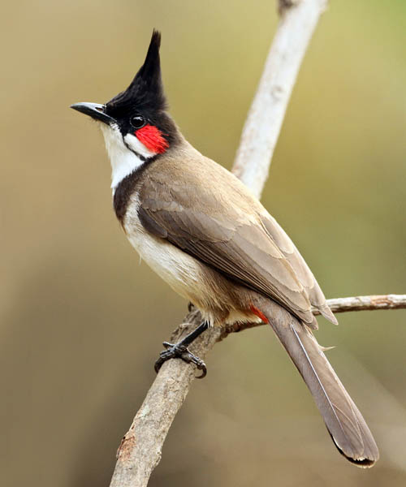
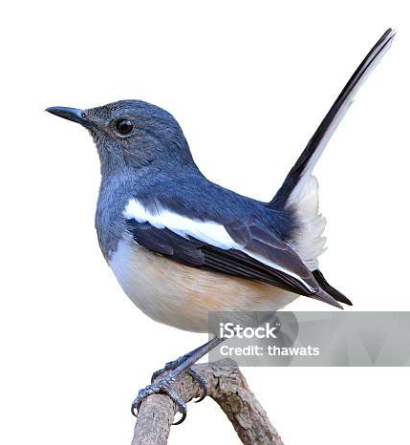
Perching feet
Characteristics of the order Passeriformes or Perching Birds, eg., crows, bulbuls, robins, sunbirds, weavers, flycatchers, mynas etc.
Three toes are anterior and slender, while one toe or hallux is posterior, strongly built and opposable, so that they can securely fasten the foot to a branch or a perch.
Toe of House Crow
Red-whiskered Bulbul
Oriental Magpie Robin

Slide 5
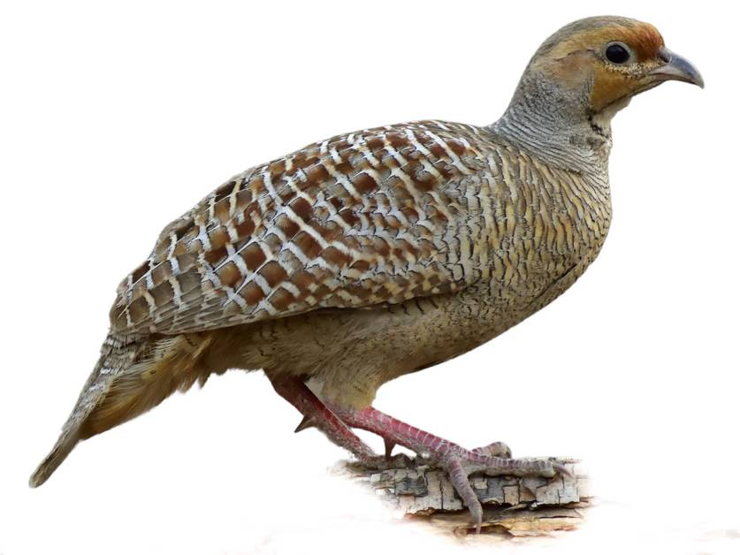
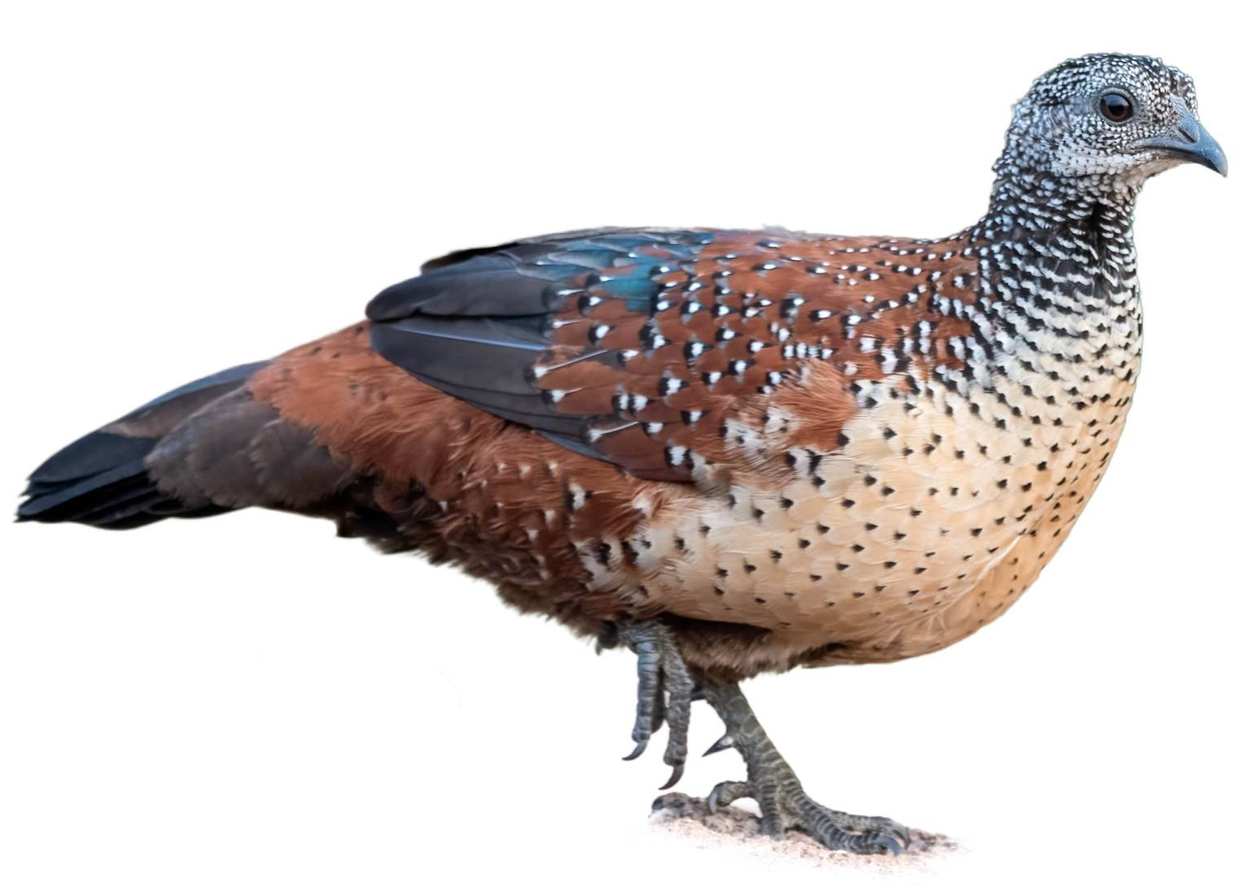
Scratching Feet
The feet of fowls, quails, pheasants, etc., are stout, with strongly developed claws and well adapted for running as well as scratching the earth.
The foot of a male bird is usually provided with a pointed bony spur for offence and defence.
Grey Francolin
Painted Spurfowl

Slide 6
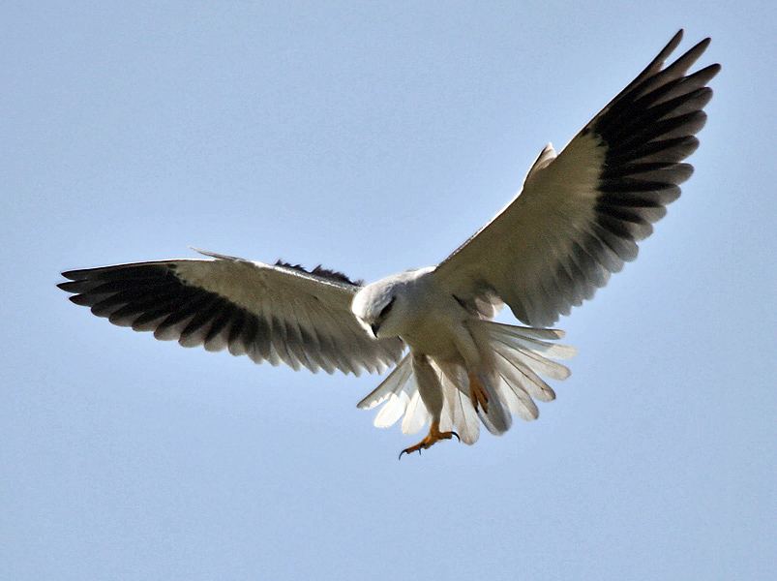
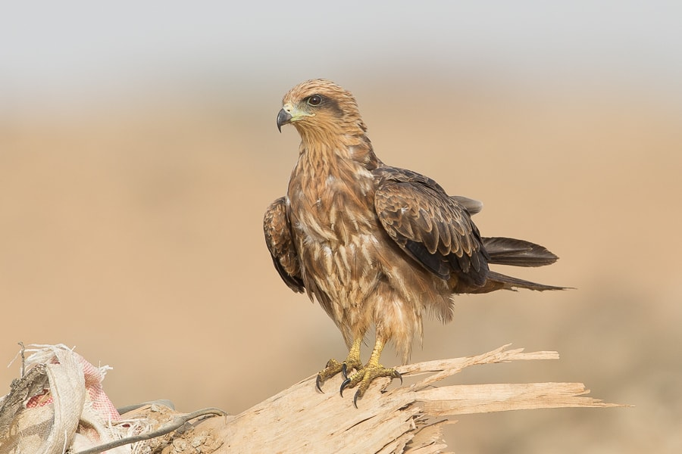
Raptorial Feet
Predatory or carnivorous birds, such as eagles, kites, vultures, owls, etc., have strongly taloned feet for striking and grasping their prey.
The toes have strongly developed, sharp and curved claws (talons). Large and fleshy bulbs, called tylari, are found on the undersurface of the toes, especially developed in the sparrow-hawk.
In osprey and Ketupa, tylari are absent, but horny spines are present, which help in gripping slippery prey such as fish.
Black winged Kite
Black Kite

Slide 7
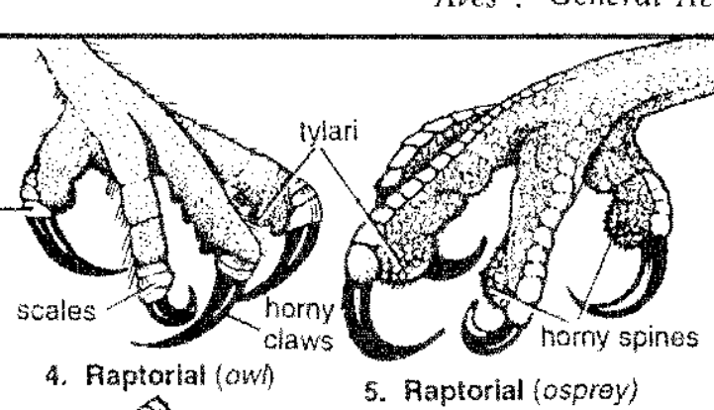
Raptorial feet

Slide 8
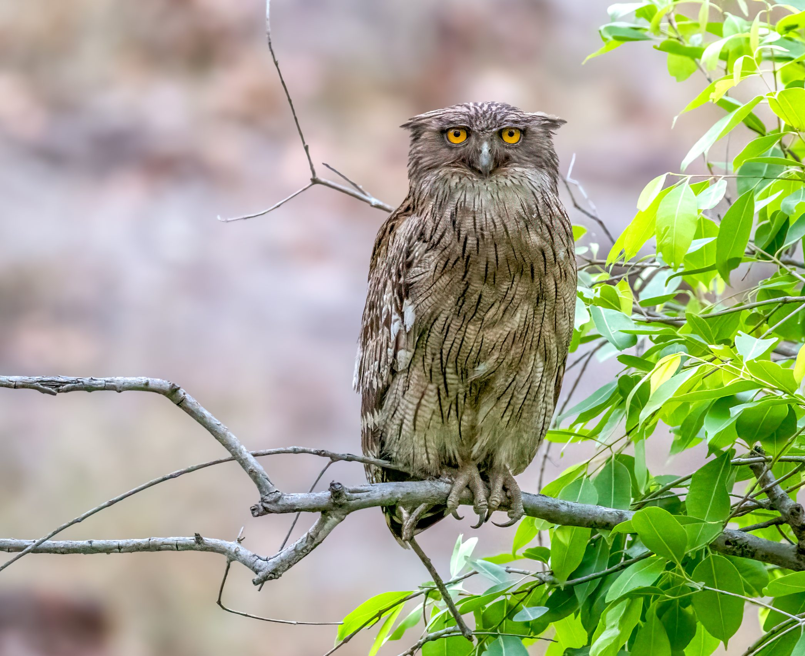
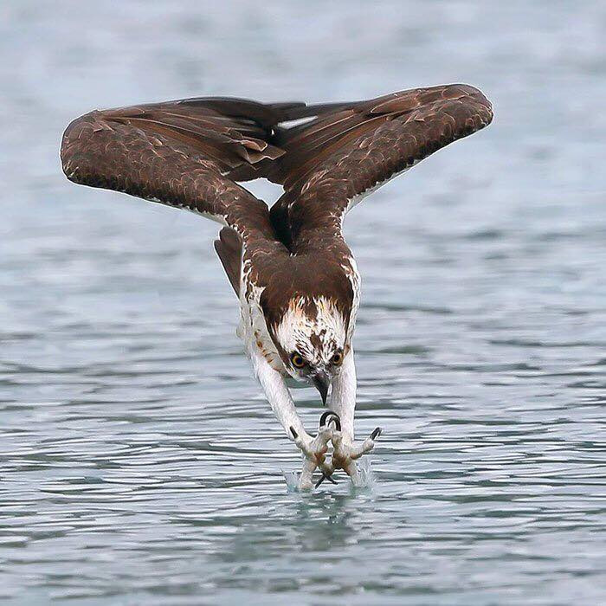
Raptorial feet
Buffy Fish Owl
Osprey

Slide 9
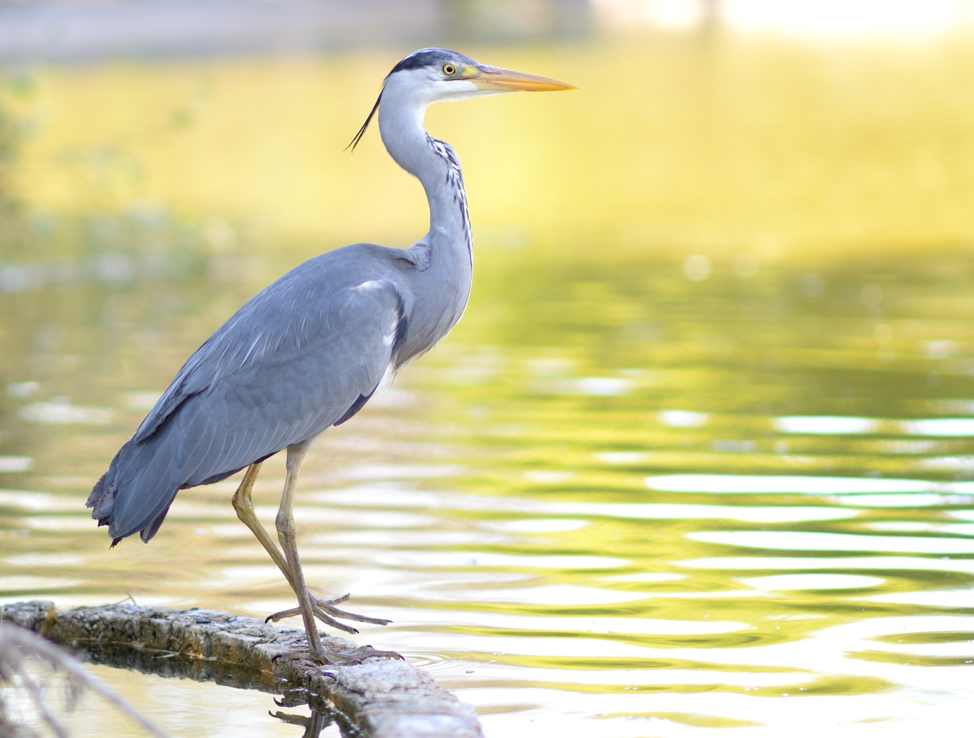
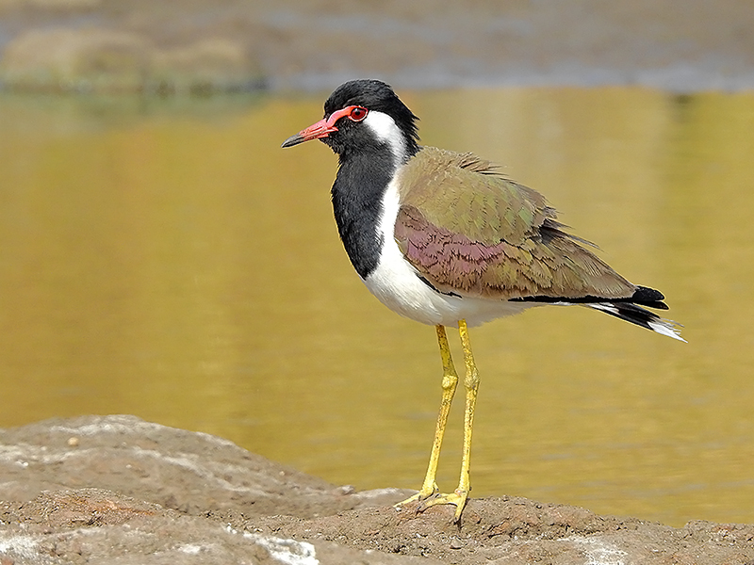
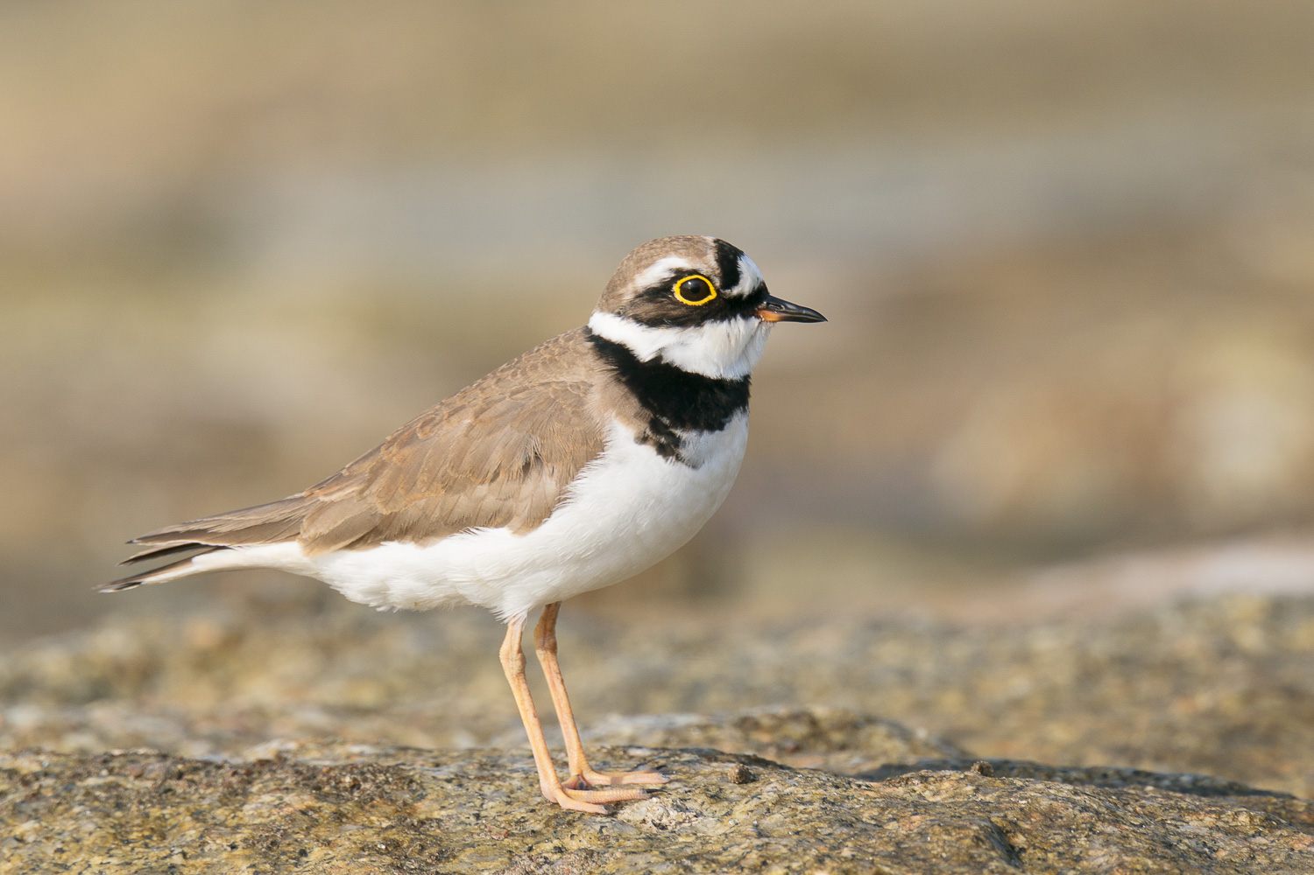
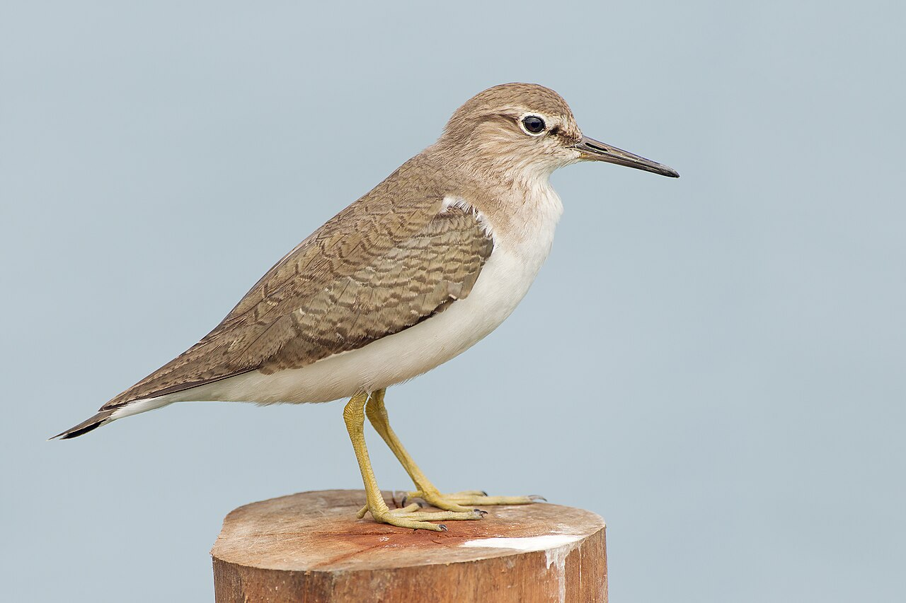
Wading feet
The legs and toes are exceptionally long and slender in wading or marshy birds such as herons, snipes, jacanas, lapwings, etc.
These serve to walk over aquatic vegetation or marshes.
The web is absent or feebly developed.
Grey Heron
Red-wattled Lapwing
Little Ringed Plover
Common Sandpiper

Slide 10
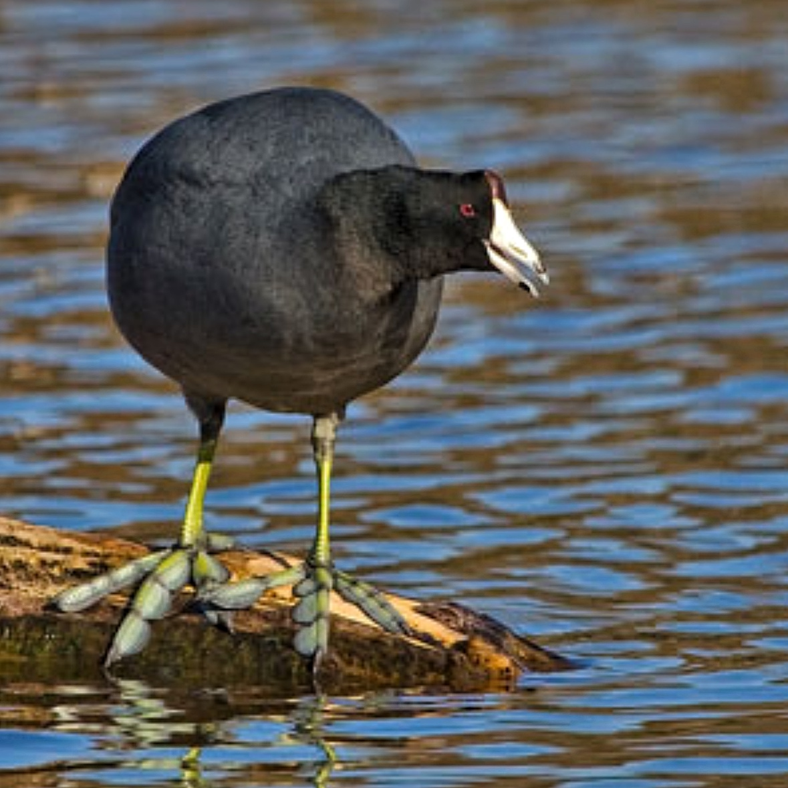
Swimming Feet
In swimming birds, the toes are webbed, partially or completely.
In diving birds, like coots and grebes, the web is lobate, and the toes are free.
In swimming and paddling birds, such as ducks and teals, only the anterior three toes are united in a web.
In pelicans and cormorants, all four toes are enclosed in the web
Eurasian Coot showing lobate feet

Slide 11
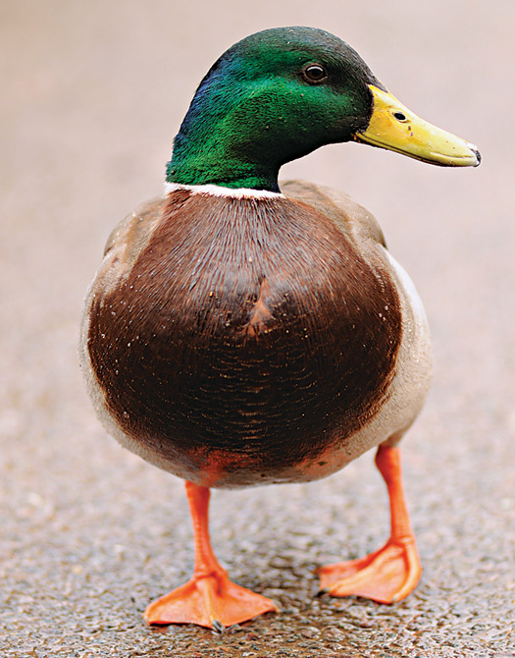
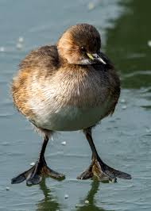
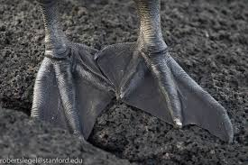
Swimming feet
Little Grebe
Feet of Cormorant
Mallard

Slide 12
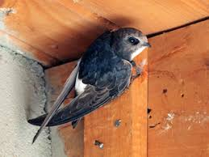
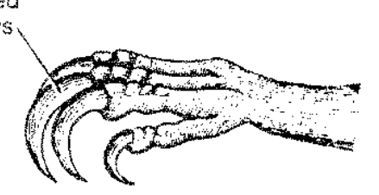
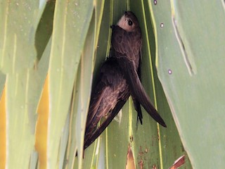
Clinging Feet
In swifts, martinets and humming-birds, all the four toes point forwards and serve to cling to steep faces of cliffs or under caves of houses, etc.
Little Swift
Asian Palm Swift

Slide 13
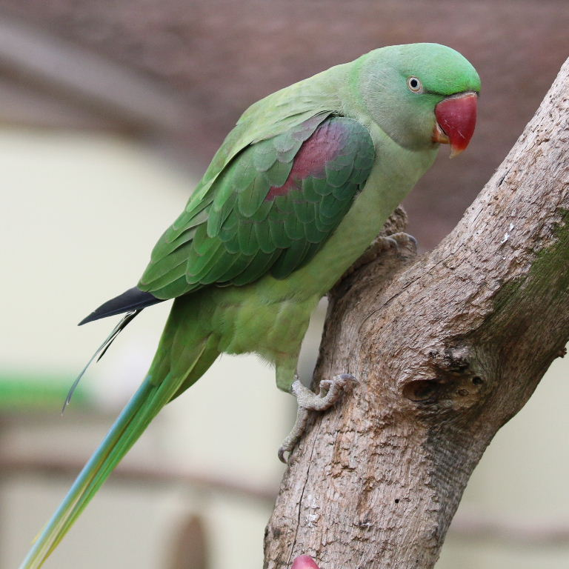
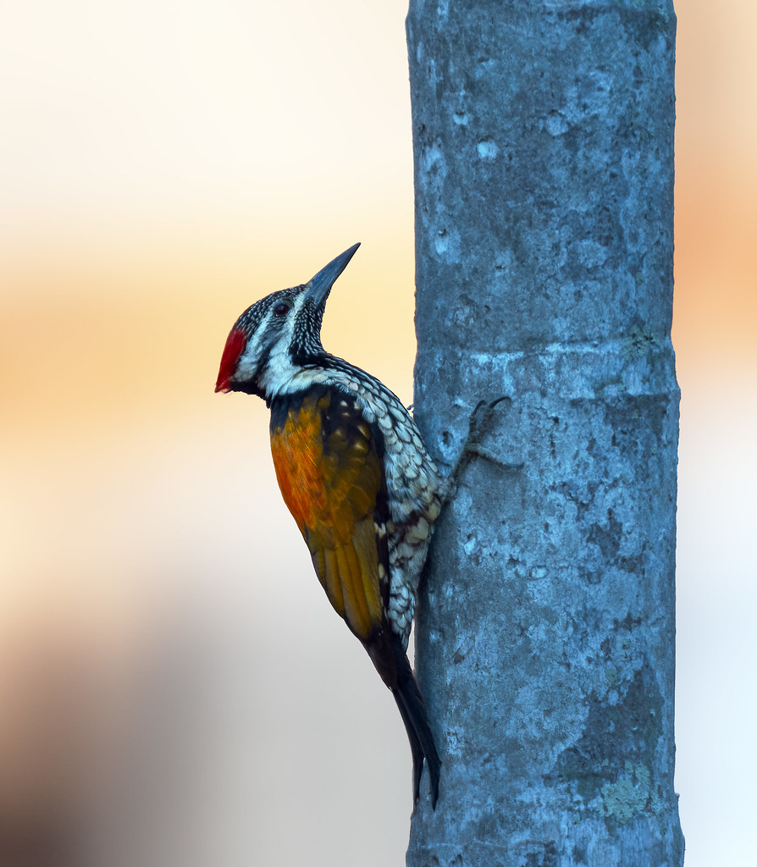
Climbing feets
In parrots and woodpeckers the feet are used as grasping organs and especially adapted for climbing vertical surfaces.
The second and third toes point in front, while the first and fourth toes point backwards
Alexandrine Parakeet
Lesser Flameback Woodpecker

Slide 14
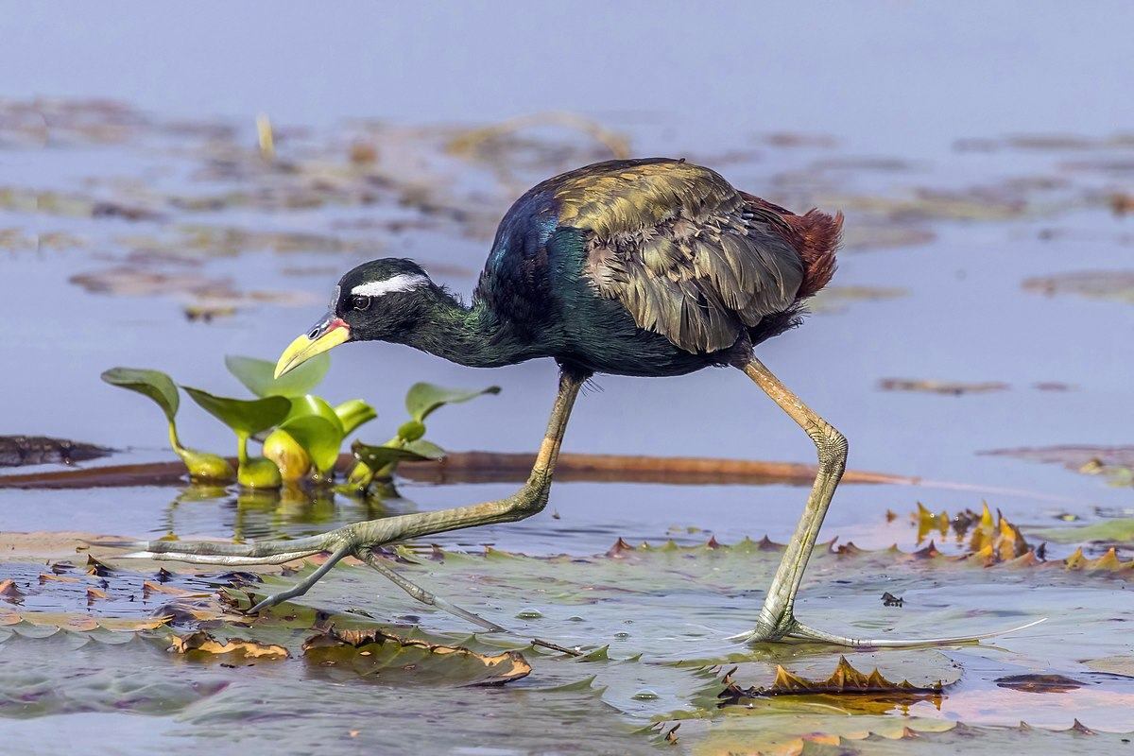
Water skiing foot
Bronze-winged Jacana
Jacanas have extremely elongated clawed toes to walk over unstable surfaces such as floating leaves

